Slide 1
Amazon Kinesis

Slide 2
Amazon Kinesis Managed Service for Streaming Data Ingestion & Processing
Origins of Kinesis
The motivation for continuous, real-time processing
Developing the ‘Right tool for the right job’
What can you do with streaming data today?
Customer Scenarios
Current approaches
What is Amazon Kinesis?
Kinesis is a building block
Putting data into Kinesis
Getting data from Kinesis Streams: Building applications with KCL
Connecting Amazon Kinesis to other systems
Moving data into S3, DynamoDB, Redshift
Leveraging existing EMR, Storm infrastructure
2

Slide 3
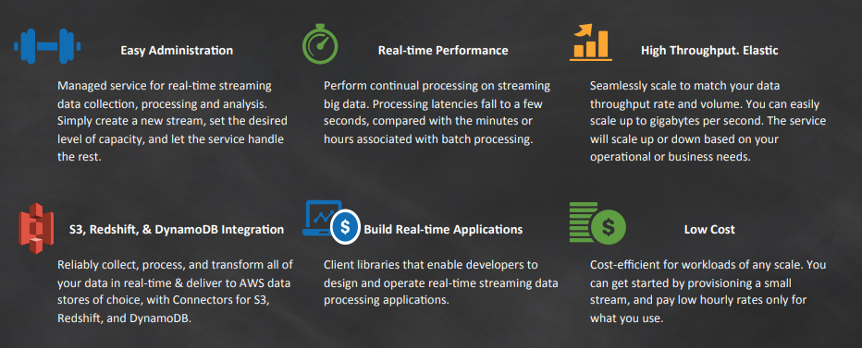
Amazon Kinesis: Key Developer Benefits
3

Slide 4
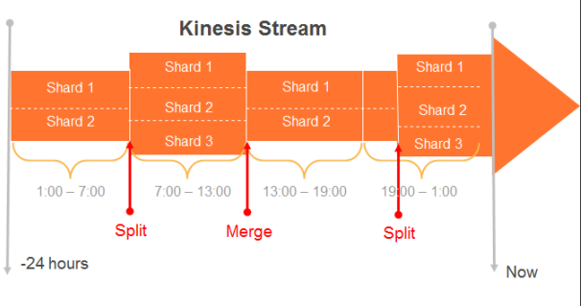
Kinesis Stream: Managed ability to capture and store data
Streams are made of Shards
Each Shard ingests data up to 1MB/sec, and up to 1000 TPS
Each Shard emits up to 2 MB/sec
All data is stored for 24 hours
Scale Kinesis streams by adding or removing Shards
Replay data inside of 24Hr. Window
4

Slide 5
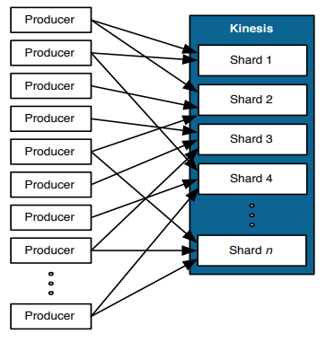
Putting Data into Kinesis Simple Put interface to store data in Kinesis
Producers use a PUT call to store data in a Stream
PutRecord {Data, PartitionKey, StreamName}
A Partition Key is supplied by producer and used to distribute the PUTs across Shards
Kinesis MD5 hashes supplied partition key over the hash key range of a Shard
A unique Sequence # is returned to the Producer upon a successful PUT call
5

Slide 6
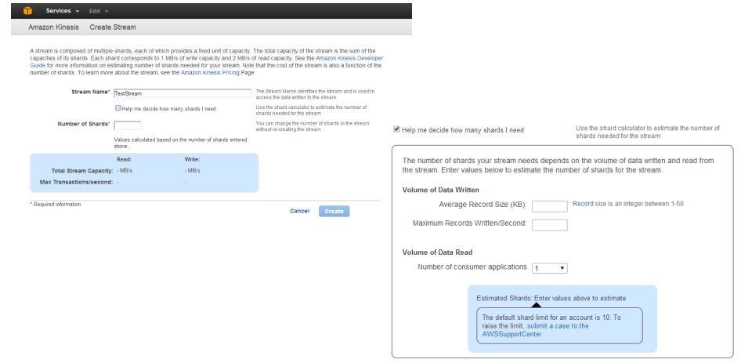
Creating and Sizing a Kinesis Stream
6

Slide 7
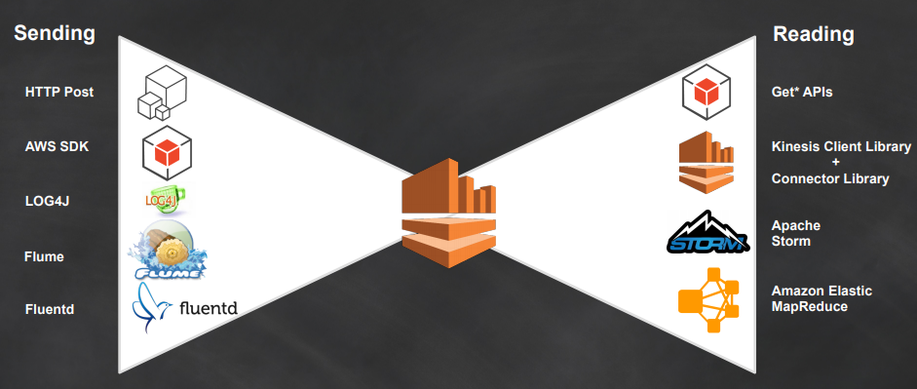
Sending & Reading Data from Kinesis Streams
7

Slide 8
Amazon Kinesis Data Streams
Amazon Kinesis Data Streams (KDS) is a massively scalable and durable real-time data streaming service.
KDS can continuously capture gigabytes of data per second from hundreds of thousands of sources such as website clickstreams, database event streams, financial transactions, social media feeds, IT logs, and location-tracking events.
The data collected is available in milliseconds to enable real-time analytics use cases such as real-time dashboards, real-time anomaly detection, dynamic pricing, and more.
8

Slide 9
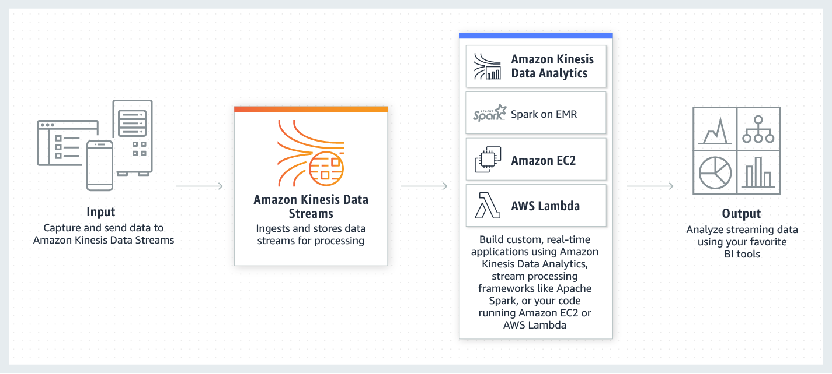
How it works
9

Slide 10
Creating a Stream
You can create a stream using the Kinesis Data Streams console, the Kinesis Data Streams API, or the AWS Command Line Interface (AWS CLI).
To create a data stream using the console
Sign in to the AWS Management Console and open the Kinesis console at https://console.aws.amazon.com/kinesis.
In the navigation bar, expand the Region selector and choose a Region.
Choose Create data stream.
On the Create Kinesis stream page, enter a name for your stream and the number of shards you need, and then click Create Kinesis stream.
On the Kinesis streams page, your stream's Status is Creating while the stream is being created. When the stream is ready to use, the Status changes to Active.
Choose the name of your stream. The Stream Details page displays a summary of your stream configuration, along with monitoring information.
10

Slide 11
Kinesis Data Streams Producers
A producer puts data records into Amazon Kinesis data streams. For example, a web server sending log data to a Kinesis data stream is a producer.
To put data into the stream, you must specify the name of the stream, a partition key, and the data blob to be added to the stream. The partition key is used to determine which shard in the stream the data record is added to.
All the data in the shard is sent to the same worker that is processing the shard. Which partition key you use depends on your application logic. The number of partition keys should typically be much greater than the number of shards. This is because the partition key is used to determine how to map a data record to a particular shard. If you have enough partition keys, the data can be evenly distributed across the shards in a stream.
11

Slide 12
Kinesis Data Streams Consumers
A consumer, known as an Amazon Kinesis Data Streams application, is an application that you build to read and process data records from Kinesis data streams.
When you build a consumer, you can deploy it to an Amazon EC2 instance by adding to one of your Amazon Machine Images (AMIs). You can scale the consumer by running it on multiple Amazon EC2 instances under an Auto Scaling group.
12

Slide 13
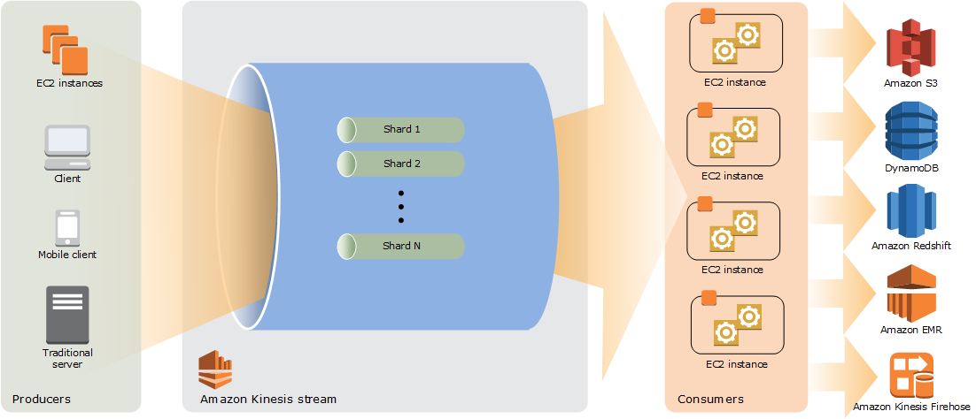
Kinesis Data Streams High-Level Architecture
13

Slide 14
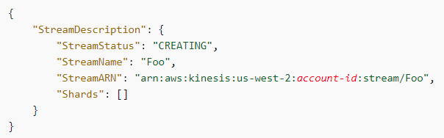
Perform Basic Kinesis Data Stream Operations Using the AWS CLI
Step 1: Create a Stream
aws kinesis create-stream --stream-name Foo --shard-count 1
aws kinesis describe-stream --stream-name Foo
aws kinesis list-streams
14

Slide 15
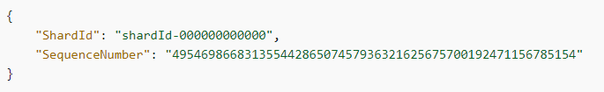
Perform Basic Kinesis Data Stream Operations Using the AWS CLI
Step 2: Put a Record
aws kinesis put-record --stream-name Foo --partition-key 123 --data testdata
Step 3: Get the Record
aws kinesis get-shard-iterator --shard-id shardId-000000000000 --shard-iterator-type TRIM_HORIZON --stream-name Foo
15

Slide 16
Amazon Kinesis Data Firehose
Amazon Kinesis Data Firehose is the easiest way to reliably load streaming data into data lakes, data stores and analytics tools.
It can capture, transform, and load streaming data into Amazon S3, Amazon Redshift, Amazon Elasticsearch Service, and Splunk, enabling near real-time analytics with existing business intelligence tools and dashboards you’re already using today.
It is a fully managed service that automatically scales to match the throughput of your data and requires no ongoing administration.
It can also batch, compress, transform, and encrypt the data before loading it, minimizing the amount of storage used at the destination and increasing security.
16

Slide 17
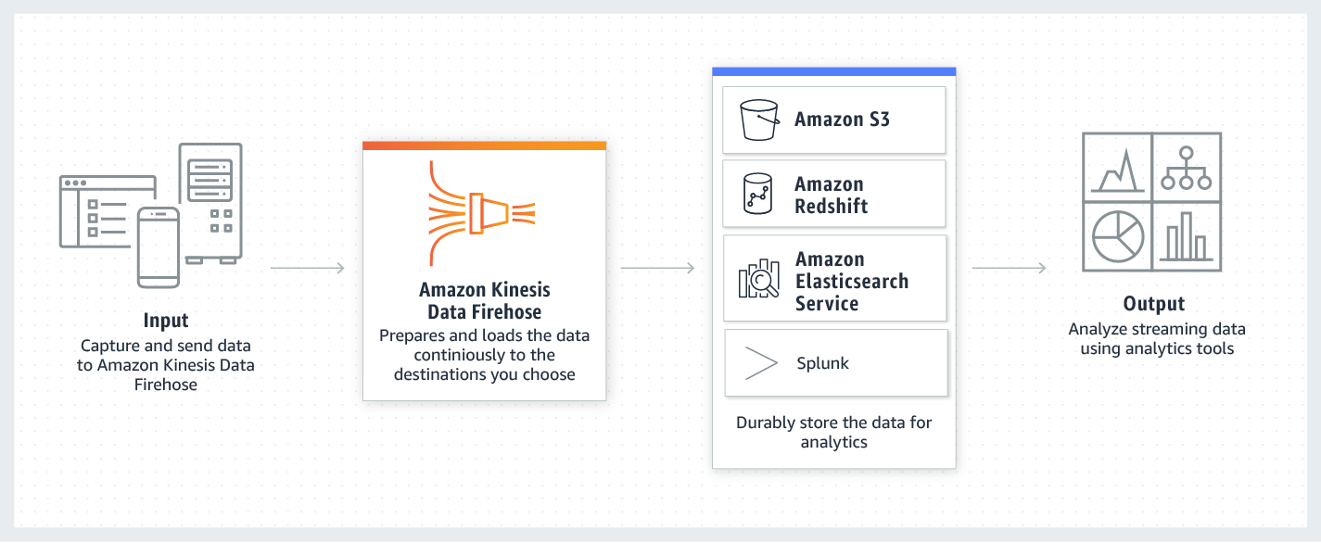
How it works
17
Use the provided link for more details. https://docs.aws.amazon.com/emr/latest/ManagementGuide/emr-what-is-emr.html

Slide 18
Thank You

